Slide 1
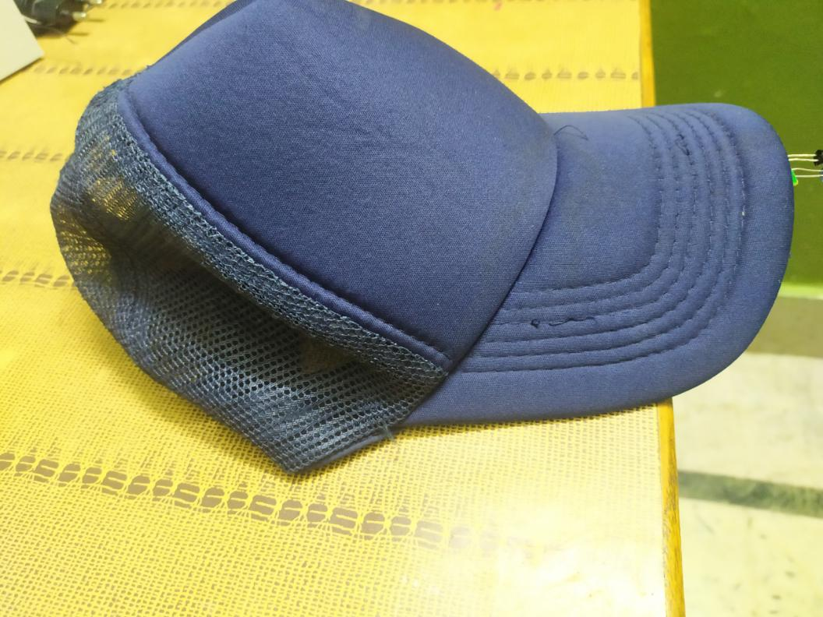

Social Distancing Cap
Fetures
This Cap Help us to maintain social distancing .Whenever some object/Person comes close more then 1-M then it automticlly buzzer out.The Buzzer Sound is so Shrink that person has to maintain a distance othewise the alarm will continue to beep.

Slide 2
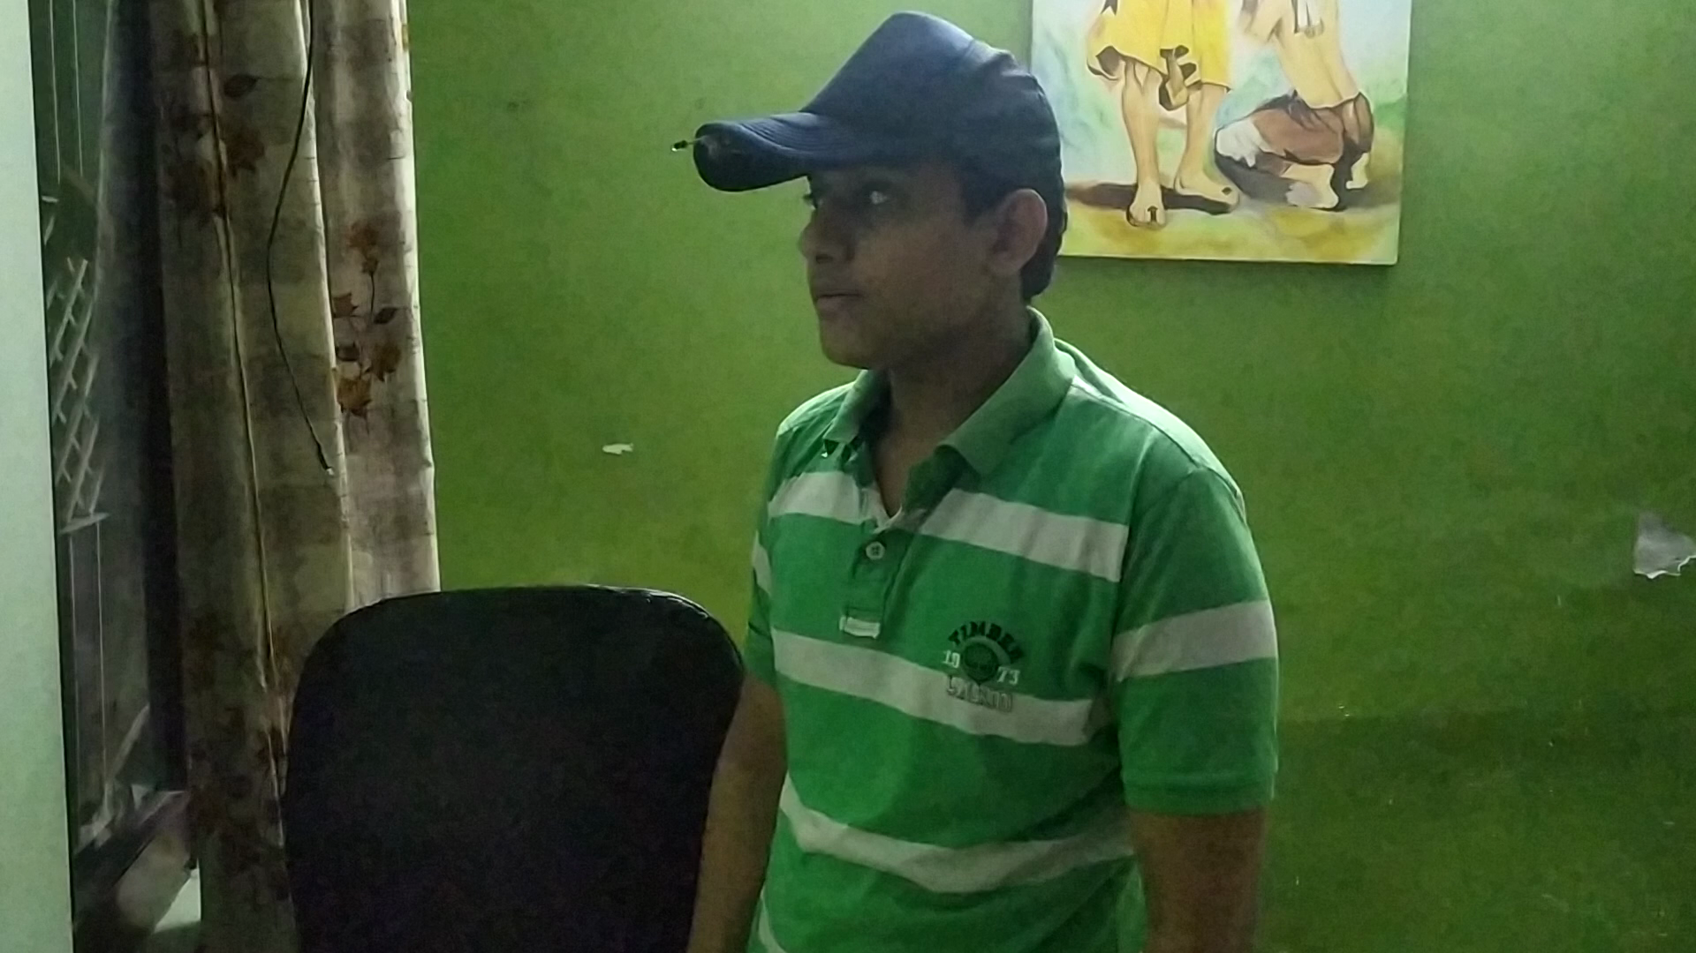

Social Distancing Cap
BEEEP!
WORKING
IT WORKS ON SIMPLE CIRCUIT OF AND BUZZER,MICRO CANTROLLER BATTERY ULTRASONIC SENSOR.POWERD BY ORDINARY GALVANIC CELL WHICH ARE ADJUATED INSIDE THE CAP SO THAT IT IS NOT VISIBLE FROM OUTSIDE.AND ALSO MAKE IT COMFORTABLE TO WEAR. NOTE-( DISTANCE CAN ALSO BE ADJSUTED TO APPROX 3 METER.)
Buzzer
+
Battery
-
ultrsonic sensor
0.5 M
micro cantroller

Slide 3
Social Distancing Cap
EQUIPMENTS
ORDINARY CAP -RS100
ULTRASONIC SENSOR -RS 130
Micro Cantroller-Rs 300
OTHERS- RS 20 (WIRES/SOLDER)
TOTAL RS 550(single) Bulk Manfacturing Cost-Rs300(approx)
MARKET SCOPE
IT CAN BE USED IN COLLEGE/SCHOOL/GOVERMENT INSITUTION WE CAN ALSO SELL IT IN MARKET WITH DIFFRENT CAP DESIGN AS IT COST VERY LOW SO THAT AN ORDINARY MIDDLE CLASS PERSON COULD ALSO AFFORD IT.THE COST CAN FURTHER BE CUT DOWN TO RS 300 BY MANUFACTURING IT IN BULK.IF YOU BUY A BRANDED NIKE/REBOOK/ADIDAS CAP IT CAN COST YOU AROUND 1200 WHILE OUR CAP COST ONLY RS 300 .

Slide 4
Social Distancing Cap
BUDGET DETAIL
TECHNICAL ASSISTANT(FOR HELP IN MANUFACTURING) -RS 10000/MONTH(APPROX)
SOLDERING STATION-RS 1700
INITIAL ORDER OF MICRO CANTROLER-RS 5000 for bulk (approx 35pc)
INITIAL ORDER OF SENSOR -RS 3000 FOR BULK(approx 40pc)
INITIAL ORDER OF CAPS -RS 5000 FOR BULK(LATEST FASHIONABLE CAPS) approx 40pc
TOTAL - RS 25000
BUISNESS MODEL
OUR MAIN FOCUS WILL BE TO MAKE IT MORE ATTRACTIVE AND COOL AS MOST OF YOUTH LOOKS FOR FASHION .WE CAN ALSO SEND OUR PROPOSAL TO GOVERMENT /COLLEGES/FIRMS /FACTORY/HOSPITAL TO BUY OUR CAP .I HAVE DECIDED TO HAVE A MARGIN OF RS 100 ON EACH CAP FOR ME AND RS 100 MARGIN FOR THE RETAILERS/MEDIATOR. MARGIN CAN FURTHER BE ADJUSTED ON THE BASIS OF PRODUCTION COST.

